Slide 1

Vel Tech Rangarajan Dr. Sagunthala R&D Institute of Science and Technology
School of Computing
Department of Computer Science and Engineering
10211CS224 / FULL STACK APPLICATION DEVELOPMENT (JAVA)
PROJECT REVIEW : MILESTONE PROJECT – 1
Date: 02-03-2026
Relational Inventory Control & Stock Tracking System
SDG: SDG No –9 ( Quality Education)
Presented By: SANGA CHANDU VTU27286 Reg.No.23UECS0505
Courses Handling Faculty: Dr. S. Hemamalini-M.E., Ph.D.,

Slide 2
INTRODUCTION
1
2
3
➤ A Relational Inventory Control & Stock Tracking System is a software application used to manage product stock efficiently. ➤ It helps businesses track inventory levels, stock movement, and product details in real time. ➤ The system maintains data using a relational database (tables with relationships). ➤ It monitors stock-in, stock-out, supplier, and sales information. ➤ It reduces human errors in manual inventory management. ➤ It provides real-time alerts for low stock levels. ➤ It improves accuracy, efficiency, and decision-making.
4
5
6
7
8
9

Slide 3
PROBLEM STATEMENT
1
2
➤ Many businesses manage inventory manually using Excel or paper records. ➤ Manual tracking leads to stock miscalculations and data loss. ➤ No real-time stock visibility. ➤ Overstocking increases storage cost. ➤ Understocking leads to customer dissatisfaction. ➤ Difficult to track supplier and sales history. ➤ Lack of reporting and analytics for business decisions.
➤ Therefore, an automated relational inventory system is required.
3
4
5
6
7
8
9

Slide 4
OBJECTIVE(S)
1
2
3
➤ Centralize inventory data using relational database. ➤ Automate stock tracking and updates. ➤ Reduce manual errors and duplicate entries. ➤ Provide real-time stock availability. ➤ Generate reports for sales and inventory analysis. ➤ Improve operational efficiency and productivity.
4
5
6
7
8
9

Slide 5
PROPOSED SYSTEM
1
2
3
➤ Web-based centralized inventory management system. ➤ Stores products, categories, suppliers, and transactions in relational tables. ➤ Automatically updates stock during sales or purchases. ➤ Low stock alert notification system. ➤ Role-based login (Admin / Staff). ➤ Generates real-time reports and analytics. ➤ Secure authentication and authorization system.
4
5
6
7
8
9

Slide 6
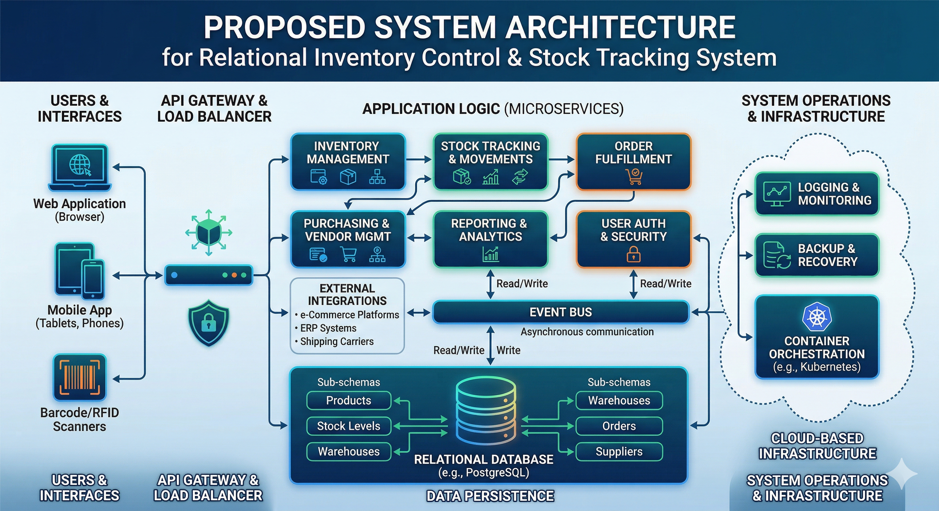
PROPOSED SYSTEM ARCHITECTURE
1
2
3
4
5
6
7
8
9

Slide 7
WORKFLOW
1
[User Login] ↓ [Add / Update Product] ↓ [Stock In (Purchase)] ↓ [Stock Out (Sale)] ↓ [Automatic Stock Update] ↓ [Report Generation] ↓ [Logout]
2
3
4
5
6
7
8
9

Slide 8
TECHNOLOGIES USED
1
➤ Frontend: HTML, CSS, JavaScript
➤ Backend: Java
➤ Database: MySQL (Relational Database)
➤ Tools: VS Code / Eclipse MySQL Workbench Apache Tomcat Git
➤ Hardware Requirements: Minimum 4GB RAM Dual-Core Processor Windows/Linux OS
2
3
4
5
6
7
8
9

Slide 9
MODULE DESCRIPTION
➤ Module 1: User Management • Admin Login • Role-based Authentication
➤ Module 2: Product Management • Add Product • Update Product • Delete Product • View Product
➤ Module 3: Supplier & Purchase Module • Add Supplier • Record Purchase • Update Stock Automatically
➤ Module 4: Sales & Billing Module • Record Sales • Reduce Stock Automatically • Generate Invoice
➤ Module 5: Reporting Module • Stock Report • Sales Report • Low Stock Alert
1
2
3
4
5
6
7
8
9

Slide 10
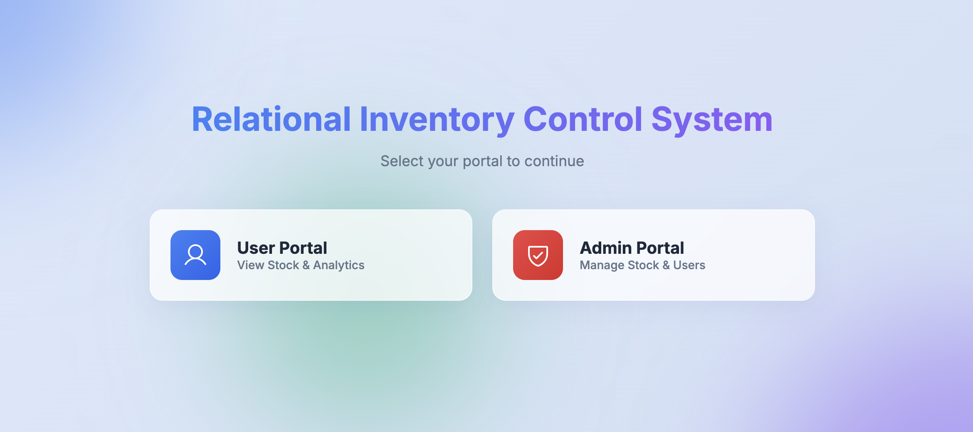
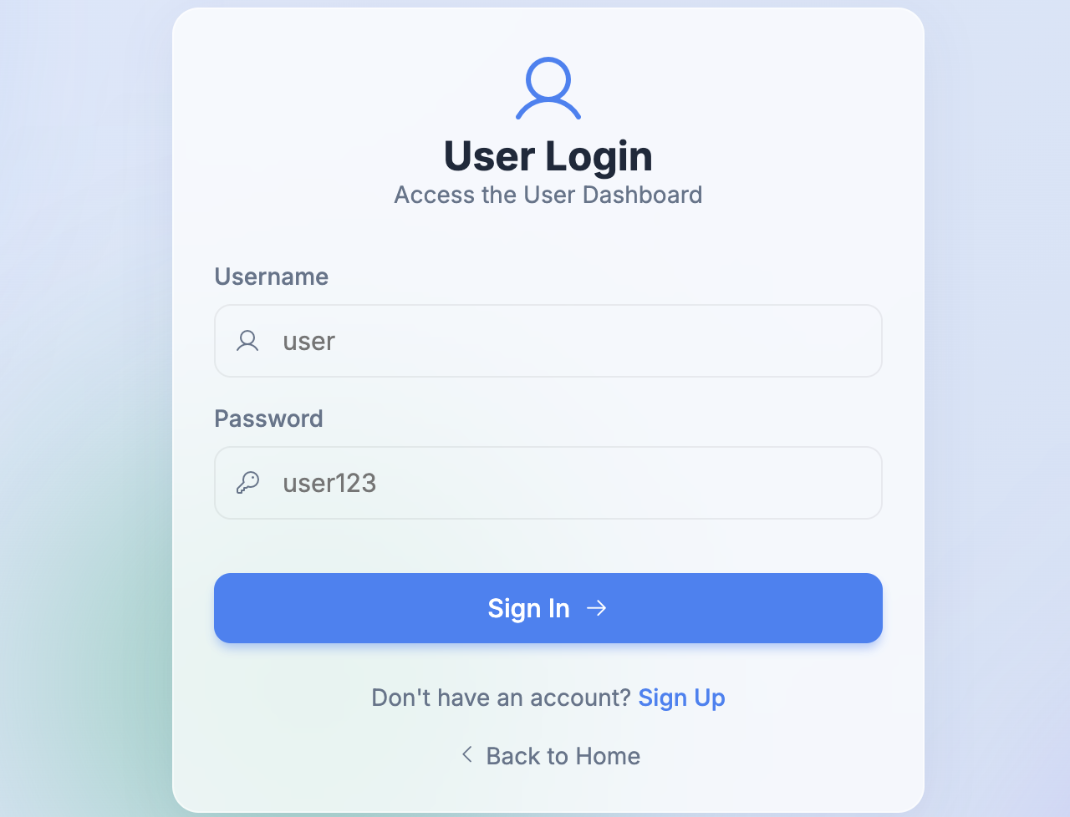
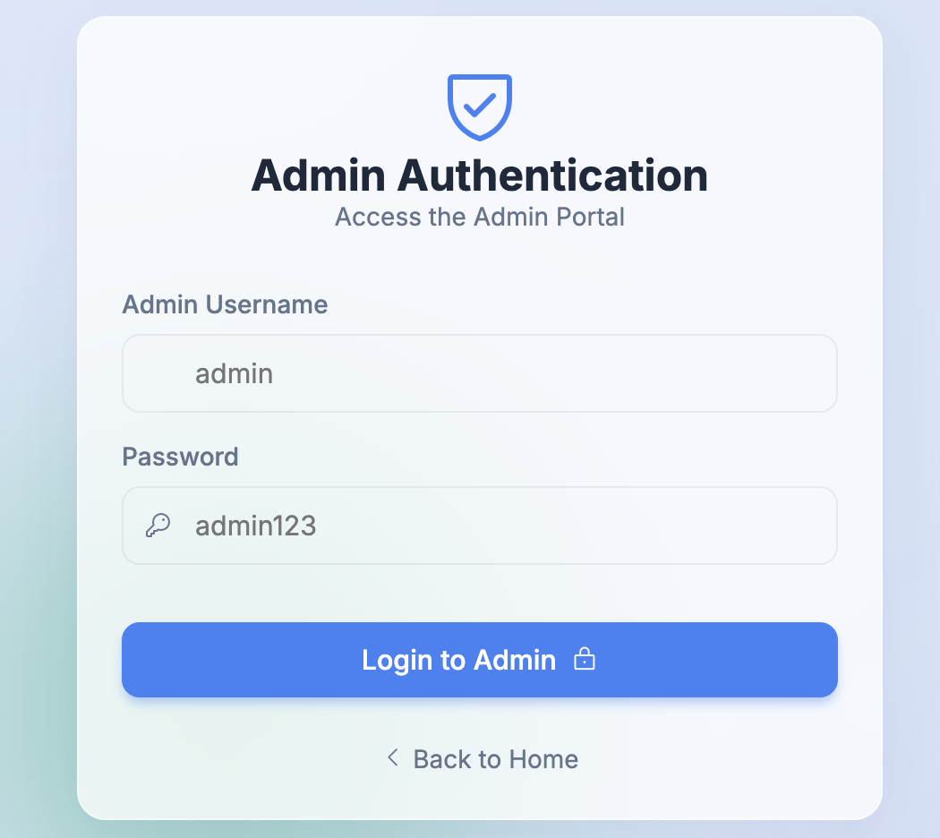
IMPLEMENTATION SCREENSHOTS
1
2
3
4
5
6
7
8
9

Slide 11
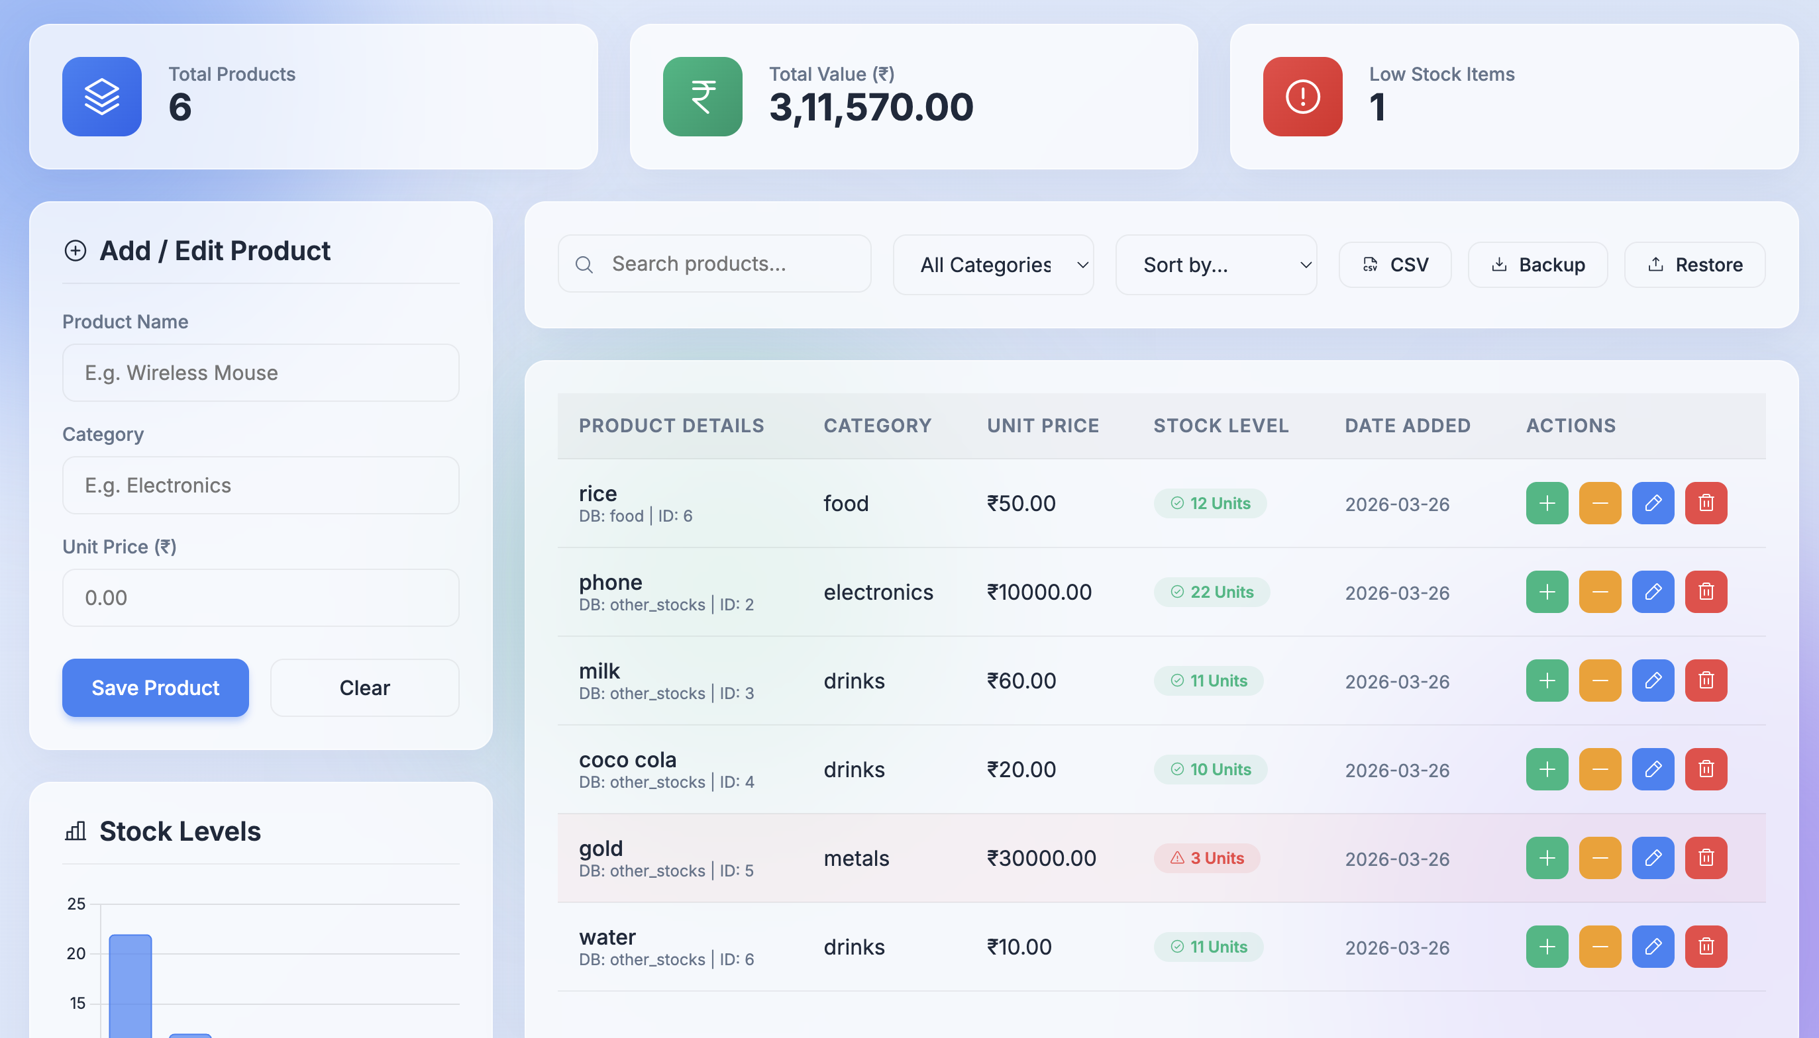
IMPLEMENTATION SCREENSHOTS
1
2
3
4
5
6
7
8(A)
9

Slide 12
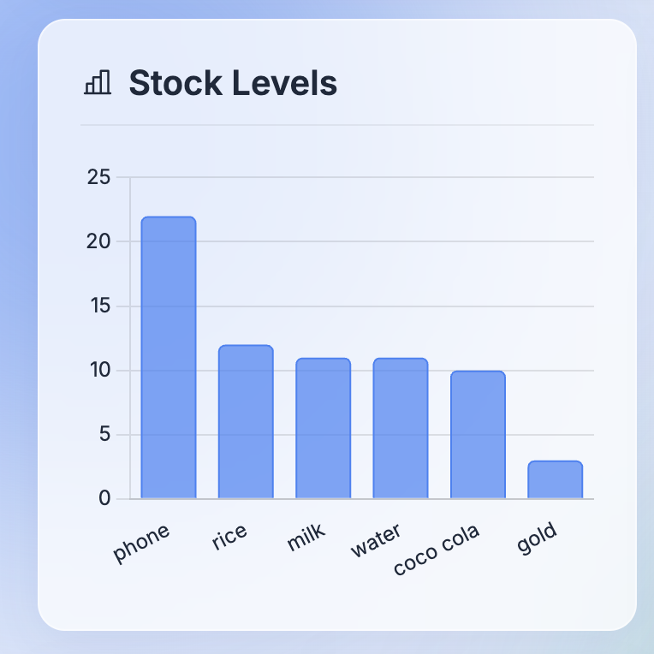
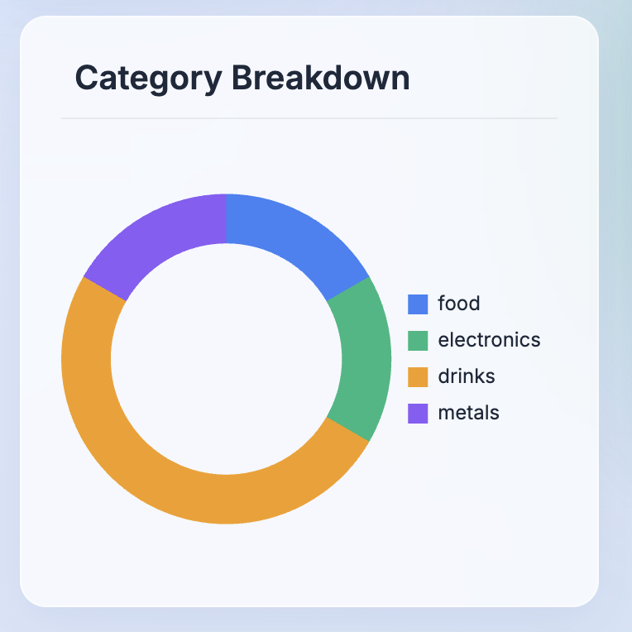
IMPLEMENTATION SCREENSHOTS
1
2
3
4
5
6
7
8(B)
9

Slide 13
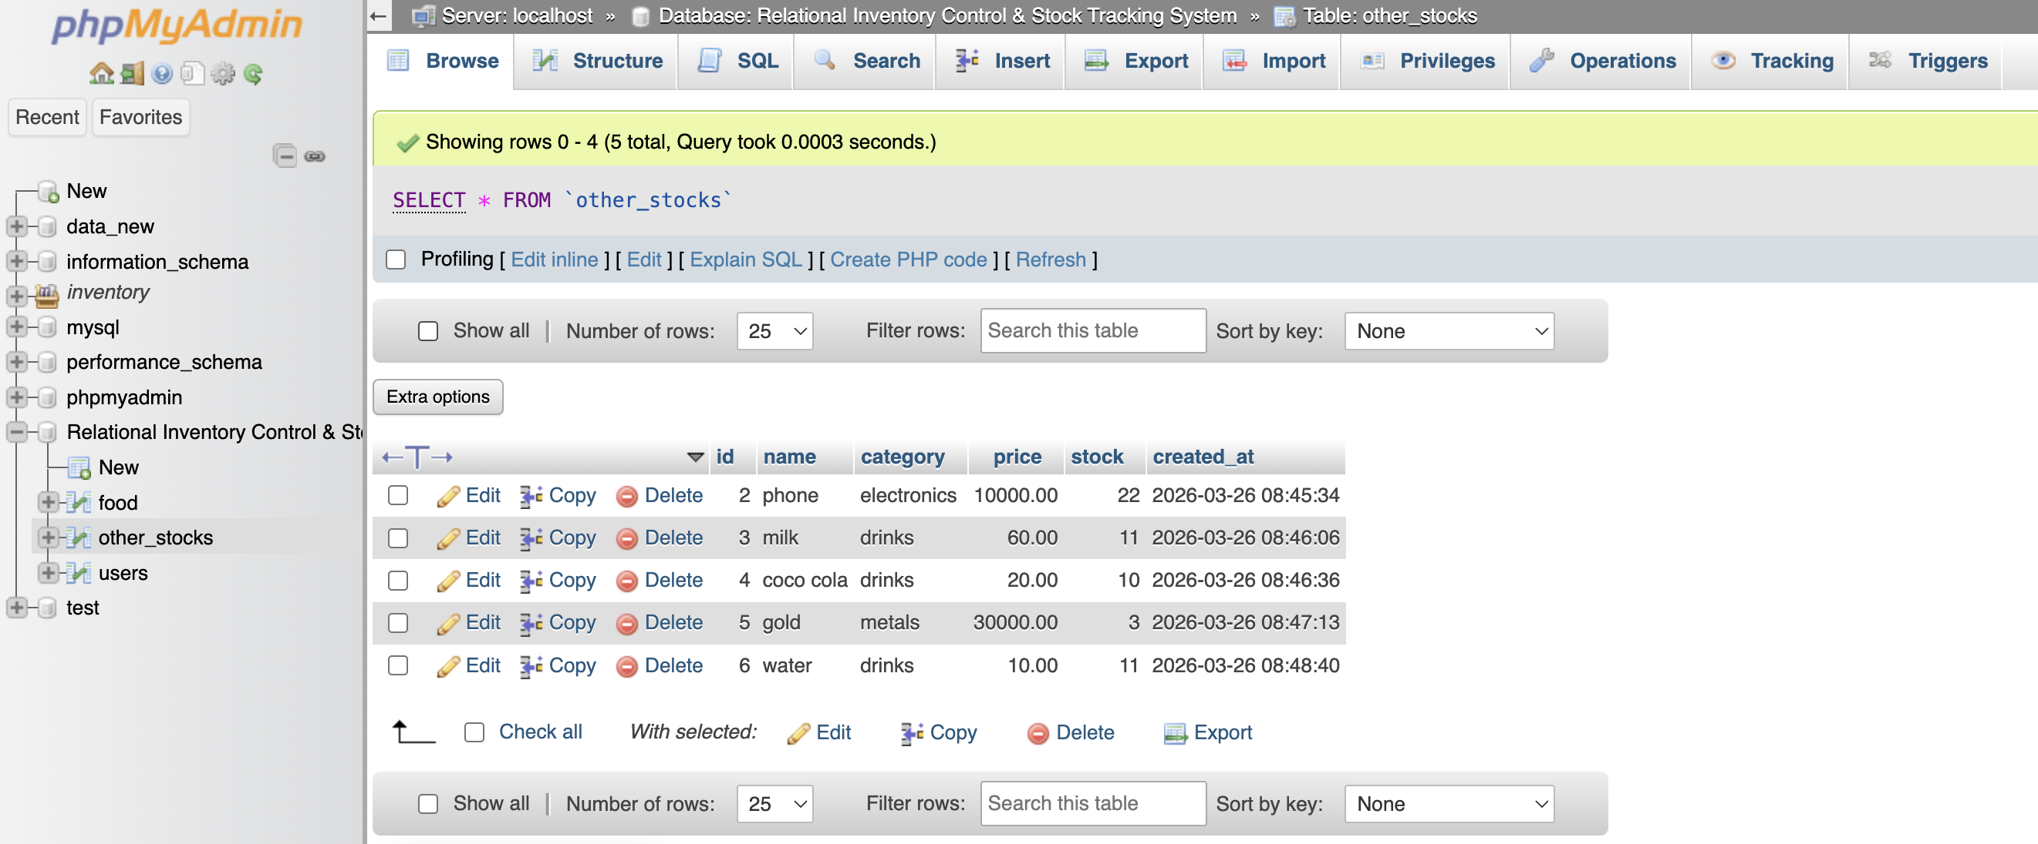
IMPLEMENTATION SCREENSHOTS
1
2
3
4
5
6
7
8(C)
9

Slide 14
ADVANTAGES & LIMITATIONS
1
2
Advantages:
➤ Centralized inventory management ➤ Real-time stock updates ➤ Reduces human errors ➤ Improves decision making ➤ Saves time and cost ➤ Secure data storage
Limitations:
➤ Requires internet connection ➤ Initial setup cost ➤ Training required for staff
3
4
5
6
7
8
9

Slide 15
Thank you

